Slide 1









INSIGHT MINDS
AI-Powered Job Market Insights
Done by:
Reham
Sogoud Moataz
Sara
Youssef
Supervised by: DR. Amal Mahmoud

Slide 2

INSIGHT MINDS
INTRODUCTION
This project analyzes the impact of Artificial Intelligenceon the labor market using a simulated dataset of more than 500 job listings. It highlights automation risks, future growth trends, and emerging skill demands across industries.

Slide 3

INSIGHT MINDS
OBJECTIVES
TRENDS
Explore employment trends influenced by AI.
JOBS
Identify vulnerable job categories at risk of automation.
INSIGHTS
Provide insights for policymakers, companies, and professionals.
SKILLS
Highlight emerging skills needed in the workforce.

Slide 4
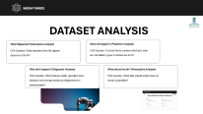
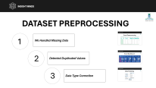
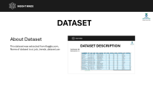


INSIGHT MINDS
METHODOLOGY
Dataset
About Dataset
Dataset Description
Data Preprocessing
Data Preparation.
Data Cleaning & Preprocessing.
Data modeling
Data Analysis
EDA
Data visualization

Slide 5
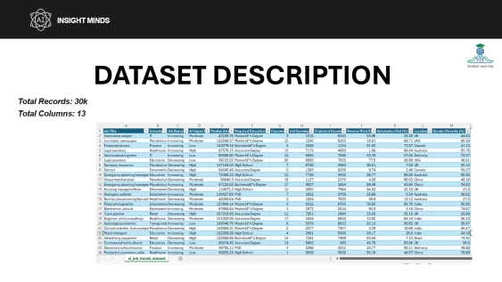
INSIGHT MINDS
DATASET
About Dataset
This dataset was extracted from Kaggle.com,
Name of dataset is ai_job_trends_dataset.csv

Slide 6
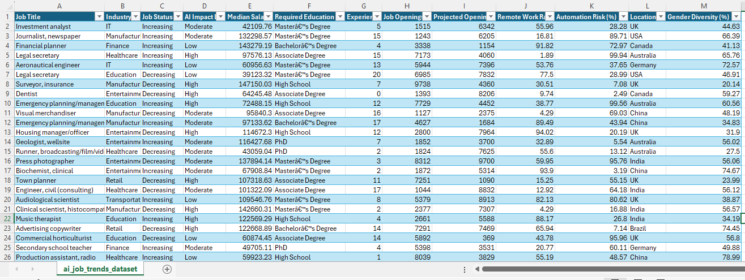
INSIGHT MINDS
DATASET DESCRIPTION
Total Records: 30k
Total Columns: 13

Slide 7
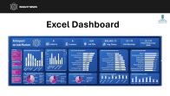
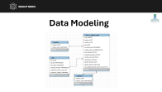
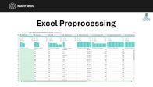
INSIGHT MINDS
DATASET PREPROCESSING
1
We Handled Missing Data
2
Detected Duplicated Values
3
Data Type Correction

Slide 8
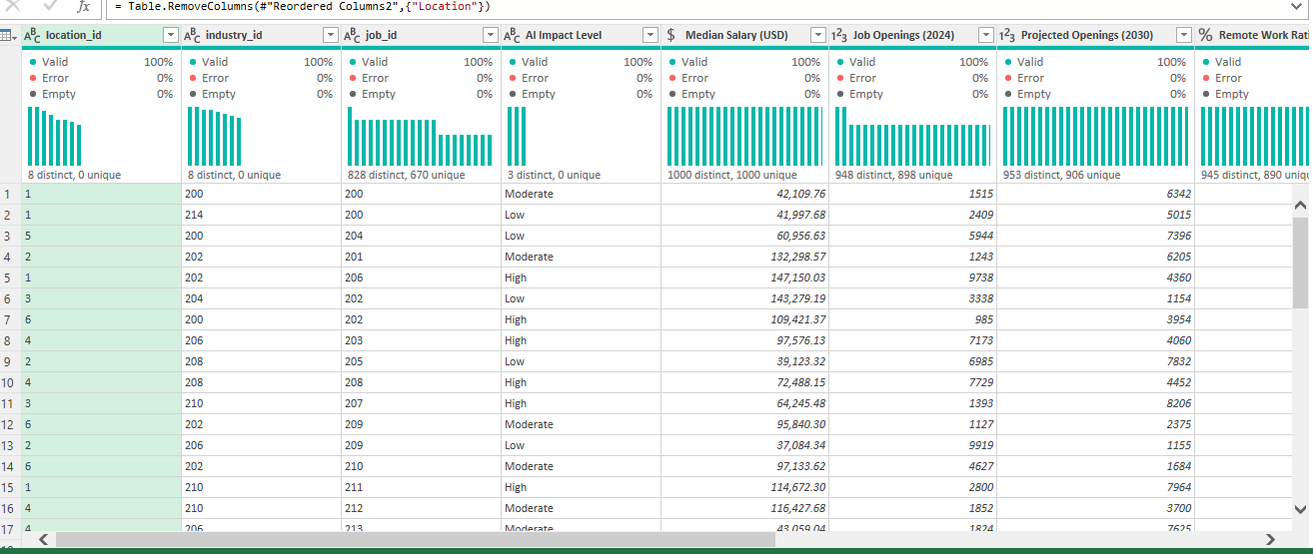
INSIGHT MINDS
Excel Preprocessing

Slide 9
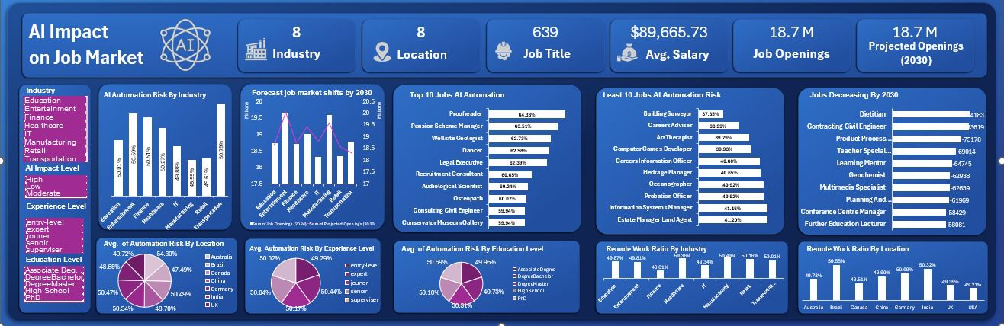
INSIGHT MINDS
Excel Dashboard

Slide 10
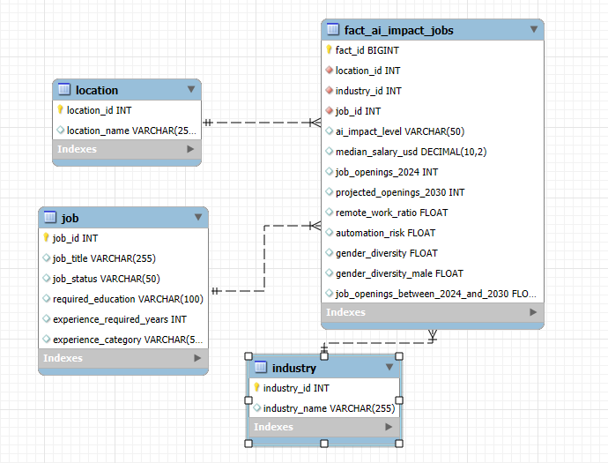
INSIGHT MINDS
Data Modeling

Slide 11
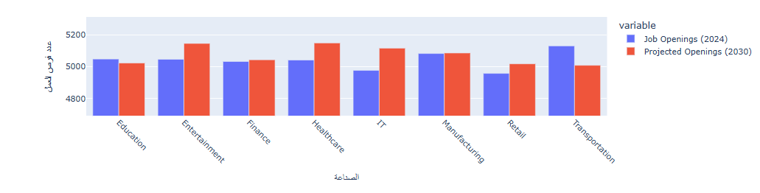
INSIGHT MINDS
Sample Data Insights (Python)
Comparison between Jobs (2024 – 2030)

Slide 12
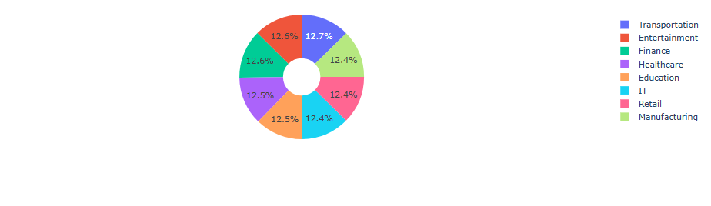
INSIGHT MINDS
Sample Data Insights (Python)
The Highest automation risk in Industry

Slide 13

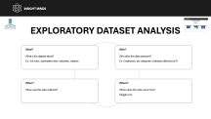
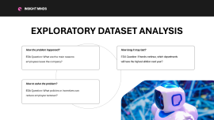
INSIGHT MINDS
DATASET ANALYSIS
What Happened? (Descriptive Analysis)
What will happen? (Predictive Analysis)
EDA Question: What industries show the highest exposure to the AI?
EDA Question: If current trends continue which jobs roles are most likely to grow or decline due to AI?
Why did it happen? (Diagnostic Analysis)
What should we do? (Prescriptive Analysis)
EDA Question: Which features (skills, education level, industry) most strongly predict job displacement or transformation?
EDA Question: What skills should workers learn to remain competitive?

Slide 14

INSIGHT MINDS
EXPLORATORY DATASET ANALYSIS
What?
Who?
What is the dataset about? Ex: Job roles, automation risks, industries, salaries.
Who does the data represent? Ex: Employees, job categories, industries affected by AI
When?
Where?
When was this data collected?
Where does this data come from?
Kaggle.com

Slide 15
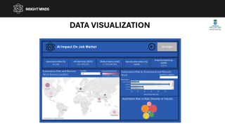
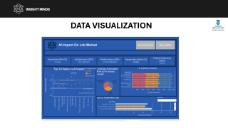
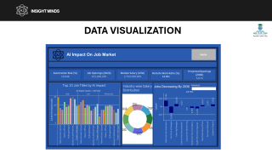
INSIGHT MINDS
DATA VISUALIZATION
TABLEAU

Slide 16
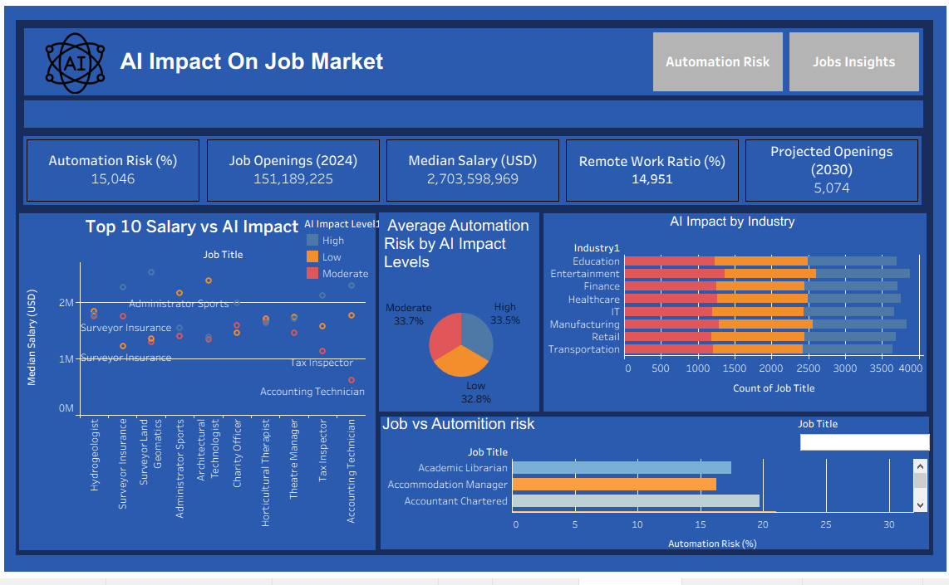
INSIGHT MINDS
DATA VISUALIZATION

Slide 17
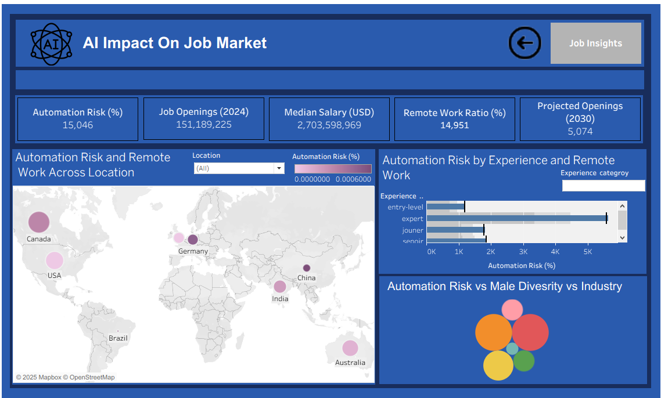
INSIGHT MINDS
DATA VISUALIZATION

Slide 18
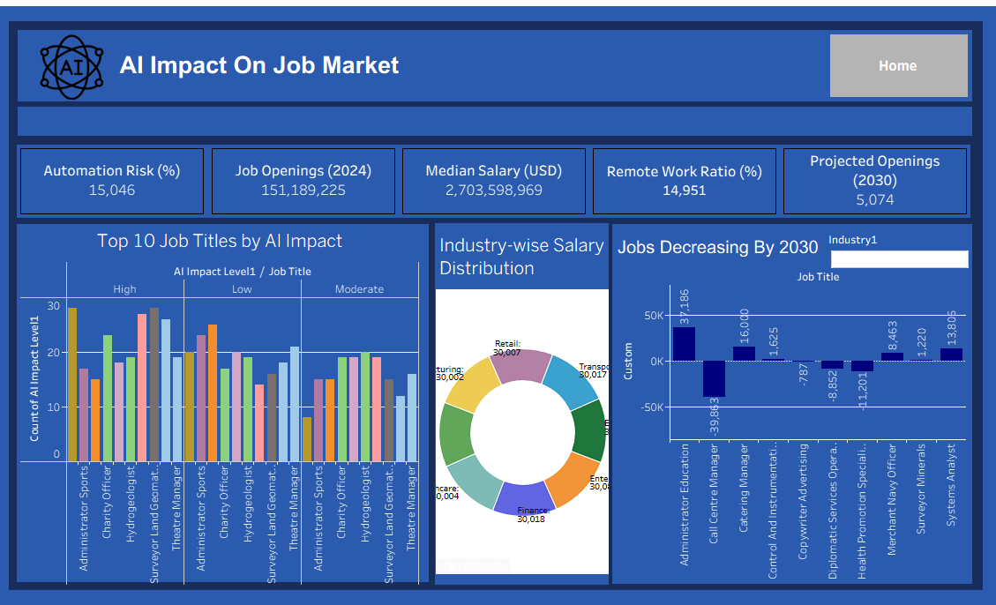
INSIGHT MINDS
DATA VISUALIZATION

Slide 19
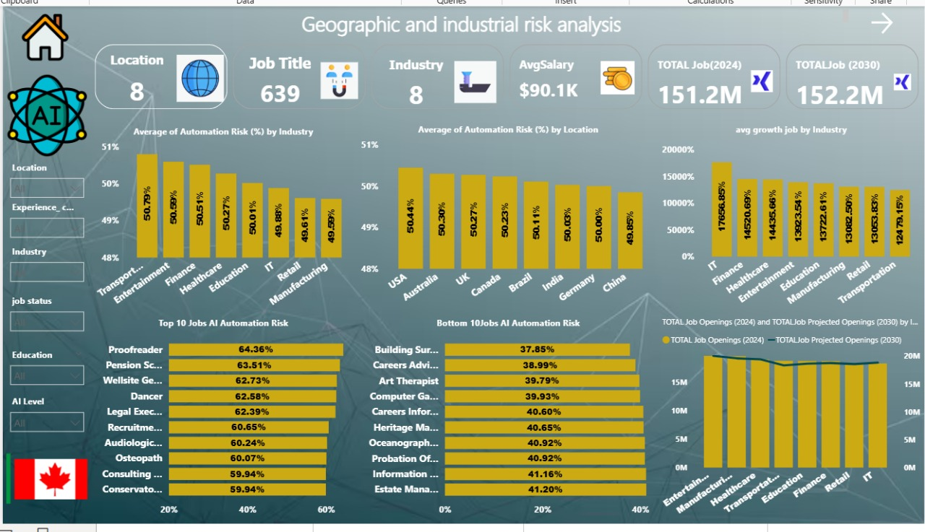
INSIGHT MINDS
DATA VISUALIZATION
Power BI

Slide 20
INSIGHT MINDS
Expected Outcomes
A clean AI job dataset integrated with visualization tools.
Execution of insights campaigns with live metrics on AI trends
Establishment of brand identity guidelines and documentation templates.
Delivery of actionable AI insights with measurable impact

Slide 21

INSIGHT MINDS
Thank You

